Slide 1

MONTHLY US EXCESS RETURN PREDICTABILITY? IN-SAMPLE, OUT-OF-SAMPLE AND C-MEAN FORECASTING unfinished project looking for help…
Hans Heytens
hansheytens@hotmail.com
0032 469 19 22 26

Slide 2
HYPERLINK TO PYTHON CODE
DataCamp:
https://app.datacamp.com/workspace/w/1d93dea6-5d25-4f57-a588-3290440e8dfe
Github repo:
https://github.com/HansHeytens/my_models/tree/main/excess_return_predictability

Slide 3
GOAL
To replicate a concept from an interesting academic paper in Python (source see credits)
Is the US short-term excess return predictable using the mean of univariate forecasts on several lagged predictors?
Short-term: monthly excess return
Excess return = US equities return – US Treasuries Bloomberg Index return
PROCESS (PYTHON)
Data cleaning and transformations.
Descriptive statistics.
Test each variable for a trend stationary process, Transform if necessary to stationary (z-scoring and differencing).
Test again. Drop series that are trend non-stationary.
Run univariate in-sample predictive ols-regressions on each potential predictor. Test for autocorrelation. Summarize.
Hypothesis test: which beta significant in-sample + R-squared in-sample?
Run univariate expanding window predictive ols-regressions on each predictor.
Run monthly return forecasts using the monthly estimated coefficients of the out-of-sample predictive regressions.
Calculate a C-mean forecast: simple average of all individual univariate forecasts.

Slide 4
PROCESS (PYTHON)
Summarize with Campbell & Thompson out-of-sample R-squared test statistic for all the individual univariate forecasts and for the C-mean forecast. This statistic tests the proportional reduction in the mean squared forecast error of the forecasts versus a naïve forecast which is the trailing, running historical average of the excess returns.
Construct a monthly trading model that dynamically allocates between us equities and treasuries using the out-of-sample C-mean forecasts.
MOTIVATION
I publish my work and learning process because of the protégé effect. I also encourage my readers to check my code, logic and discuss.
Teaching and/or explaining a process to others is the best way to learn for myself.
I encourage my readers to check my code, logic and search for any errors/mistakes.
INTENDED USE
This notebook is for illustrative and education purposes only. Feel free to use this code for these purposes.
The logic and/or python code might contain errors. All mistakes remain the author's fault. If you find any, let me know so I can rectify
LIMITATIONS AND FUTURE CHALLENGES
Limitation: This project is unfinished and stopped after running the Campbell & Thompson R-squared statistics. The statistics seem out-of-line with the academic paper and with logic. I haven’t found my error yet. Yet, I publish the results so far as always in the hope that others can contribute to the project.
Future challenges:
Solve the out-of-sample issue, the construct the trading model if confidence in the out-of-sample stats.
Include sentiment, vol variables as well as valuation indicators
Use other reducing forecasts instead of multi-variate: PCA, Ridge, Lasso,C-Net
Test for longer horizons (>1M: 3M, 6M, 1Y, 3Y); serial correlation issues here need to be adjusted for. (overlapping returns)

Slide 5
CREDITS
This code uses my own package called my_risk_kit.py for certain functions.
The idea for the trading model - to use the mean of univariate forecasts (C-mean) instead of multivariate forecasts - came from the interesting paper below:
“Rapach, David and Zhou, Guofu, Asset Pricing: Time-Series Predictability (March 24, 2022). Oxford Research Encyclopedia of Economics and Finance, Available at SSRN: https://ssrn.com/abstract=3941499 or http://dx.doi.org/10.2139/ssrn.3941499
out-of-sample stats. “

Slide 6
DATA: MONTHLY RAW DATA : Jan-1974 till Nov-2022 (csv_file)
us_equity MSCI USA large and midcaps monthly net return Bloomberg
us_treasury Bloomberg Barclays unhedged US treasury return Bloomberg
yeld_10y US 10-year treasury yield Bloomberg
yield_3m US 3-month T-bill yield Bloomberg
yield_Baa Baa yield Fred
core_pce US core PCE-deflator Bloomberg
lei_yoy US Leading Index YoY Bloomberg
ism_manuf_new_order US ISM Manufacturing New Orders Index Bloomberg
oecd_usa Leading OECD-indicator amplitude adjusted USA Bloomberg
oecd_global Leading OECD-indicator amplitude adjusted Global Bloomberg
oecd_Japan Leading OECD-indicator amplitude adjusted Japan Bloomberg
jobless_claims_4 US Jobless Claims 4-week average Bloomberg
Part_time_work US Parttime work for Economic Reasons Bloomberg

Slide 7
DATA: INITIAL TRANSFORMATIONS
excess_return us equity return – us treasury return
log_excess_return_1m logarithmic monthly excess return (np.log1p(x)) response variable
mom_1m_log same as log_excess_return_1m potential predictor if lagged
mom_3m_log cumulative 3-month log excess return potential predictor if lagged
mom_6m_log cumulative 6-month log excess return potential predictor if lagged
mom_12m_log cumulative 12-month log excess return potential predictor if lagged
yield_10y potential predictor if lagged
yield_3m potential predictor if lagged
term_spread_10y3m yield_10y – yield_3m potential predictor if lagged
yield_Baa potential predictor if lagged
core_pce potential predictor if lagged
real_yield_10y yield_10y – core_pce potential predictor if lagged
real_yield_3m yield_3m – core_pce potential predictor if lagged
real_yield_BAa yield_Baa – core_pce potential predictor if lagged
spread_Baa yield_Baa – yield_10y potential predictor if lagged
yield_10y_1mchg monthly absolute change in yield_10y potential predictor if lagged
yield_3m_1mchg monthly absolute change in yield_3m potential predictor if lagged
term_spread_10y3m_1mchg monthly absolute change in term_spread_10y3m potential predictor if lagged
yield_Baa_1mchg monthly absolute change in yield_Baa potential predictor if lagged
core_pce_1mchg monthly absolute change in core_pce potential predictor if lagged
real_yield_10y_1mchg monthly absolute change in real_yield_10y potential predictor if lagged
real_yield_3m_1mchg monthly absolute change in real_yield_3m potential predictor if lagged
real_yield_Baa_1mchg monthly absolute change in real_yield_Baa potential predictor if lagged
spread_Baa_1mchg monthly absolute change in spread_Baa potential predictor if lagged

Slide 8
DATA: INITIAL TRANSFORMATIONS
lei_yoy potential predictor if lagged
Ism_manuf_new_order potential predictor if lagged
Oecd_usa potential predictor if lagged
Oecd_global potential predictor if lagged
Oecd_japan potential predictor if lagged
Jobless_claims_4w potential predictor if lagged
Part_time_work potential predictor if lagged
lei_yoy _1mchg monthly absolute change in lei_yoy potential predictor if lagged
Ism_manuf_new_order_1mchg monthly absolute change in ism_manuf_new_order potential predictor if lagged
Oecd_usa_1mchg monthly absolute change in oecd_usa potential predictor if lagged
Oecd_global_1mchg monthly absolute change in oecd_global potential predictor if lagged
Oecd_Japan_1mchg monthly absolute change in oecd_Japan potential predictor if lagged
Jobless_claims_4w_1mch monthly absolute change in jobless_claims_4w potential predictor if lagged
Part_time_work_1m_chg monthly absolute change in part_time_work potential predictor if lagged
Total:
Period: Jan-74 till Nov-22
n: 587 months
1 Response variable: monthly logarithmic excess return
36 potential predictors: 40 potential predictors (lagged values)
- initial research on short-term forecasting (lag of 1month)
- to-do: future research on longer lags (serial correlation adjustments)

Slide 9
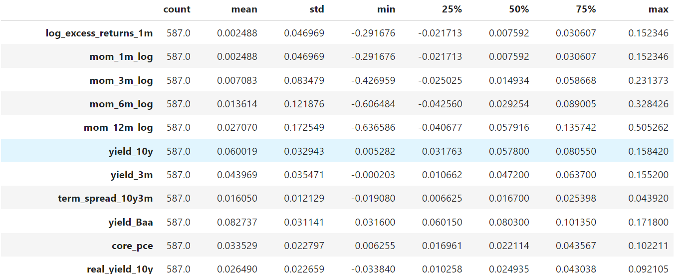
DESCRIPTIVE STATISTICS: US MONTHLY DATA
Time period: Jan/1974 – Nov/2022
Observations (n): 587 months
Response variable: 1-month log excess returns (us equity large cap returns – US treasury Barclays Index returns)
Predictors: 36 predictors
Source: copy from my notebook

Slide 10
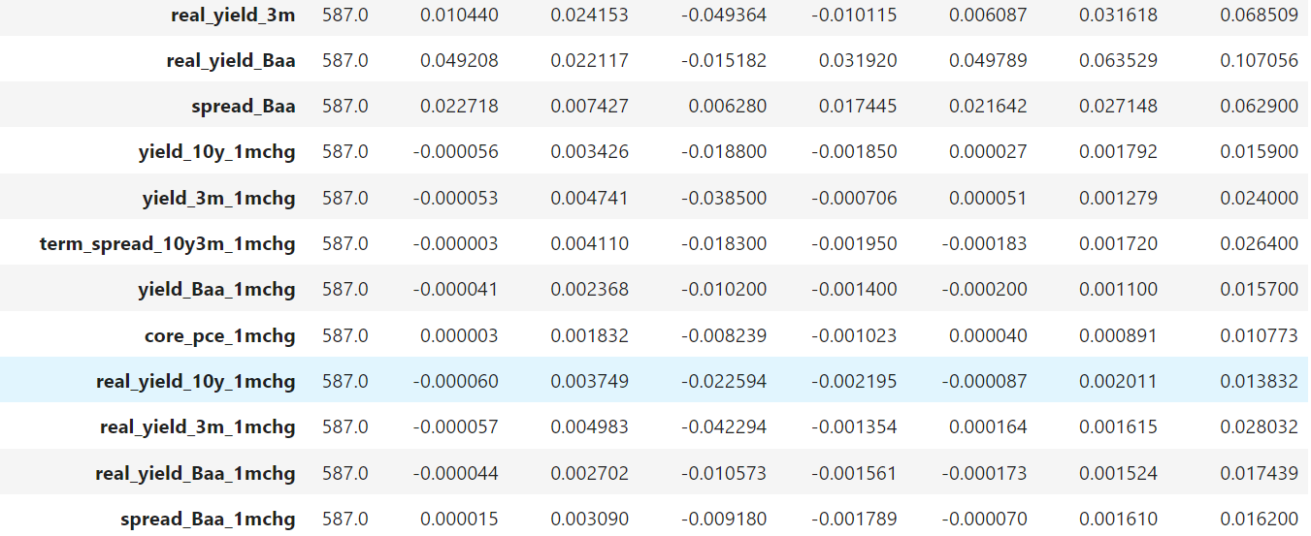
DESCRIPTIVE STATISTICS: US MONTHLY DATA
Time period: Jan/1974 – Nov/2022
Observations (n): 587 months
Response variable: 1-month log excess returns (us equity large cap returns – US treasury Barclays Index returns)
Predictors: 36 predictors
Source: copy from my notebook

Slide 11
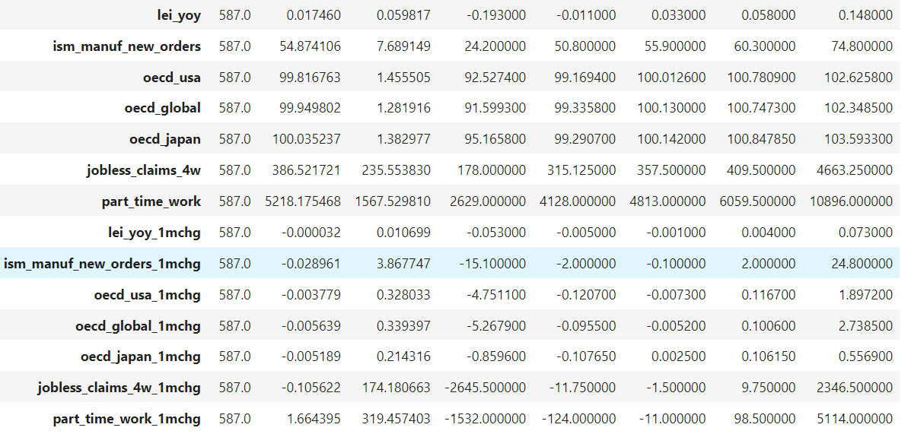
DESCRIPTIVE STATISTICS: US MONTHLY DATA
Time period: Jan/1974 – Nov/2022
Observations (n): 587 months
Response variable: 1-month log excess returns (us equity large cap returns – US treasury Barclays Index returns)
Predictors: 36 predictors
Source: copy from my notebook

Slide 12
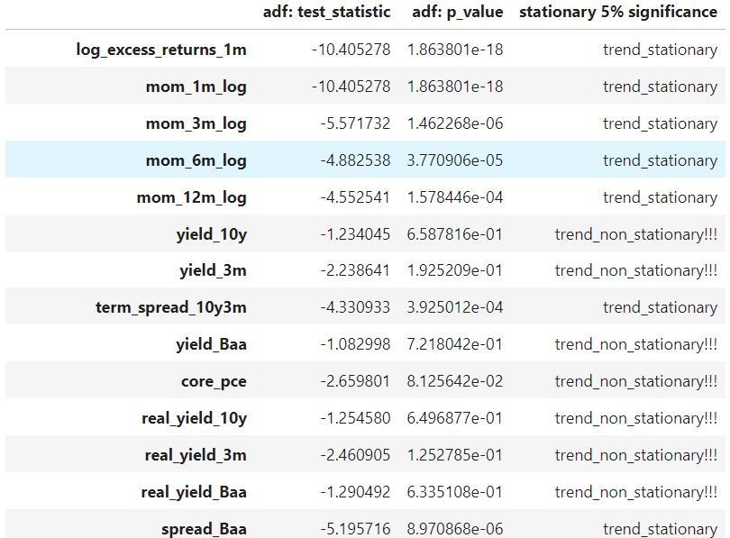
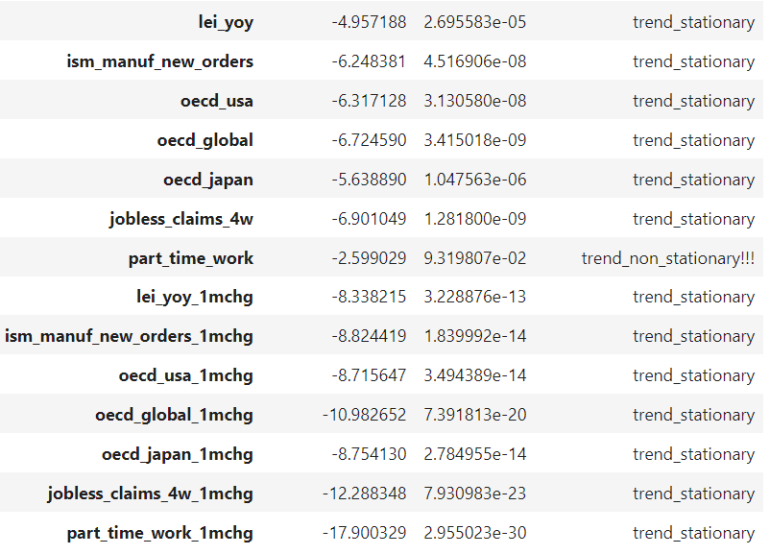
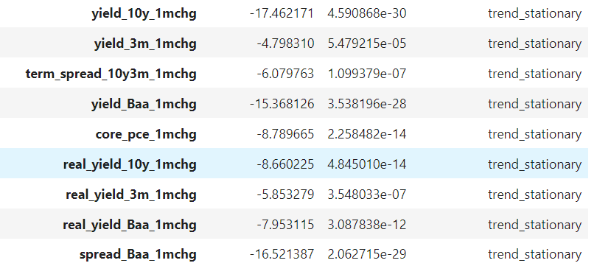
TEST FOR TREND-STATIONARY PROCESS ON THE RAW VARIABLES – augmented Dickey-Fuller
Source: copy from my notebook

Slide 13
TEST FOR TREND-STATIONARY PROCESS ON THE RAW VARIABLES – augmented Dickey-Fuller
Some series (levels) are trend non-stationary. We have already introduced differences on these series in our predictors (the 1mchg = the 1-month difference between values).
We first transform all series into standardized variables for in-sample testing. We calculate the z-score on each predictor in-sample. This creates look-ahead bias, but in-sample testing has look-ahead bias anyway as the regression is performed on the full sample. Coefficients are estimated using the full sample. These coefficients are useful for an investor today but were not known for an investor in the past. Hence, back-testing on these coefficients is unrealistic. We will solve this by out-of-sample predictive forecasting.
If there is still a trend-stationary process after normalizing, we try to log and sqrt the raw levels (and then normalizing). If there is still a stationary process after these transformations, we remove the variable from future in-sample and out-of-sample testing.

Slide 14
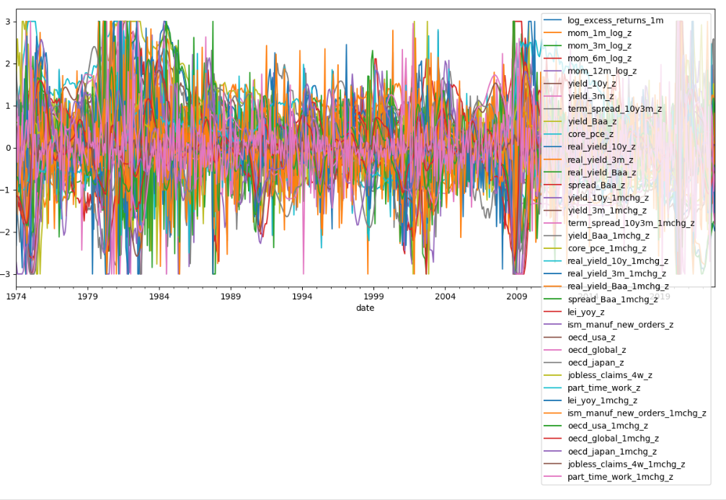
TEST FOR TREND-STATIONARY PROCESS ON THE RAW VARIABLES – augmented Dickey-Fuller
36 potential predictors are now z-scores (in-sample, full window) trimmed to min/max at -3/+3
Source: copy from my notebook

Slide 15
TEST FOR TREND-STATIONARY PROCESS ON THE RAW VARIABLES – augmented Dickey-Fuller
Augemented Dicky-Fuller tests on transformed values shows the same result as adf on the raw series (albeit somewhat lower p_values on the suspected raws). Hence we drop the following variables (and their z-scores) for in-sample and out-of sample testing and keep the rest:
Yield_10
Yield_3m
Yield_Baa
Core_pce
Real_yield_10y
Real_yield_3m
Real_yield_Baa
Part_time_work
These series all represent levels and have trend. We keep the differences series however for future testing. We end up with 28 predictors (independent variables, regressors, exogs,…) for our in-sample testing.

Slide 16
IN-SAMPLE UNIVARIATE REGRESSIONS:
FOR 1-MONTH FORECAST HORIZONS OF EXCESS RETURN (equities – treasuries) – contains look-ahead bias.
Problem:
Are short-term monthly aggregate market returns forecastable? We know from dozens of academic papers that short-term index returns, and excess-returns are very difficult to forecast as we have lots of white noise in the short run.
It is not unusual to only find in-sample r-squared on predictive regressions (of monthly excess returns) of less than 5% and usually less than 1%.
Multi-variate regressions with lots of predictors suffer from high-dimensionality problems and some papers already showed that a naïve forecast such as a trailing mean outperforms forecasts from complex multivariate recursive regressions.
Out-of-sample predictive forecasts using recursive (expanding window: only using estimated coefficients up to time t and regressors known at time t) regressions often destroy any hope that was left from significant in-sample evidence. Academic evidence also shows that aggregate market returns might be somewhat forecastable if we (regress) forecast on longer time horizons. These regressions often suffer from serial correlation issues in the excess returns (response variable) so that significance might be wildly overstated. Hence, standard errors and hence t-stats (and p-values) are often corrected using Newey-West corrections (HAC-correction). That is for future research. For now, we still focus on monthly forecasting.
Some papers provide hope for simple univariate forecasting in the short-run. If we combine the univariate forecasts (simple averaging for example: C-mean), out-of-sample results show promise. It has been long known that forecasts can be improved by just taking lots of forecasts and then averaging them. Even more, predictors that did not provide much value in out-of-sample forecasting can have value when combined with other forecasts. Model diversification works a bit like portfolio diversification. For now, we focus on predictive forecasting using the C-mean forecast.

Slide 17
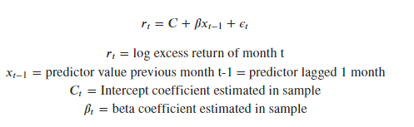
IN-SAMPLE UNIVARIATE REGRESSIONS:
FOR 1-MONTH FORECAST HORIZONS OF EXCESS RETURN (equities – treasuries) – contains look-ahead bias.
Univariate in-sample regressions:
We hypothesize that monthly excess returns are not forecastable in-sample. The alternative is that they are to some extend.
Null: beta is 0
Alternative: beta is different from 0 (t-test)
We run an in-sample regression on each variable of the form:
Firstly, we run in-sample univariate regressions on all predictors. We check for first order correlation with Durbin Watson test.
We check signs and significance of betas.
To be aware of:
The in-sample univariate OLS uses the whole sample: this creates look-ahead bias. Hence, all results should be regarded with sceptism. Yet, the industry still uses results from in-sample significance tests in reports a lot.
The in-sample univariate OLS uses standardized regressors (z-score). But the standardization also creates look-ahead bias as the z-score is calculated using the full sample (not on a rolling or expanding window).

Slide 18
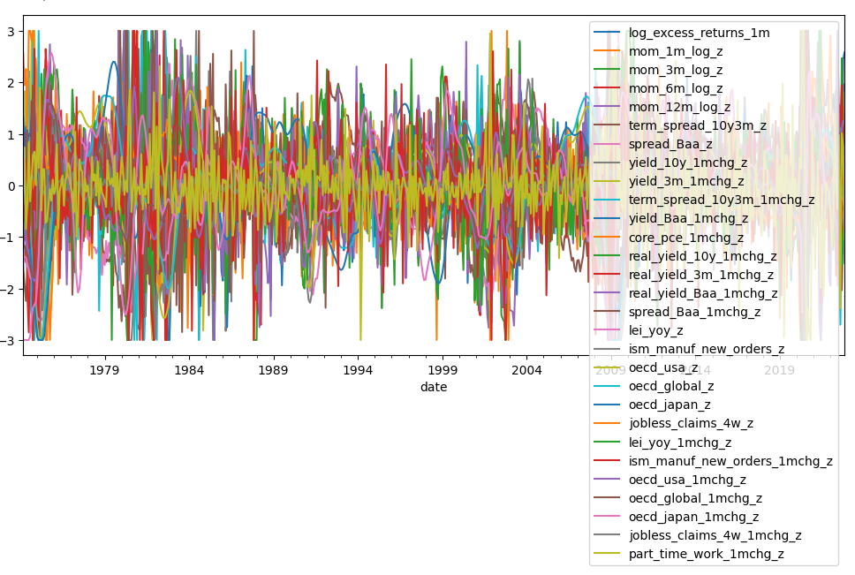
IN-SAMPLE UNIVARIATE REGRESSIONS:
FOR 1-MONTH FORECAST HORIZONS OF EXCESS RETURN (equities – treasuries) – contains look-ahead bias.
28 potential predictors (we dropped 8 due to trend non-stationary) as z-scores (in-sample, full window) trimmed to min/max at -3/+3
Source: copy from my notebook

Slide 19
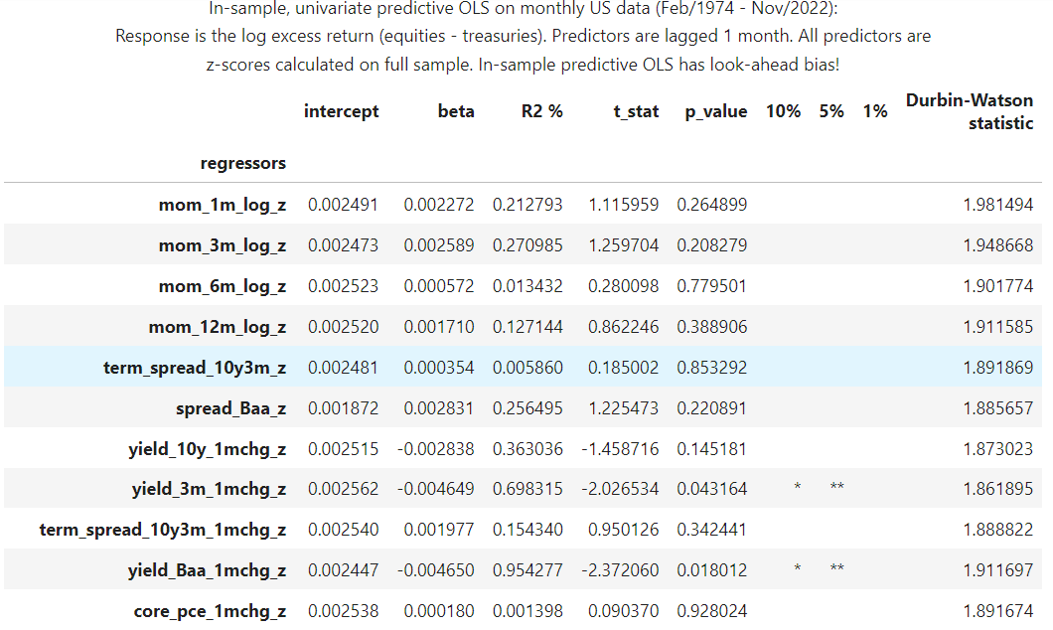
IN-SAMPLE UNIVARIATE REGRESSIONS:
FOR 1-MONTH FORECAST HORIZONS OF EXCESS RETURN (equities – treasuries) – contains look-ahead bias.
Source: copy from my notebook

Slide 20
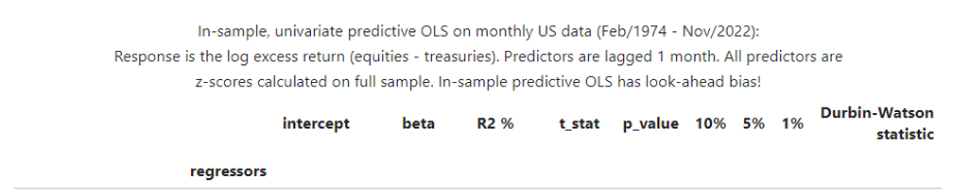
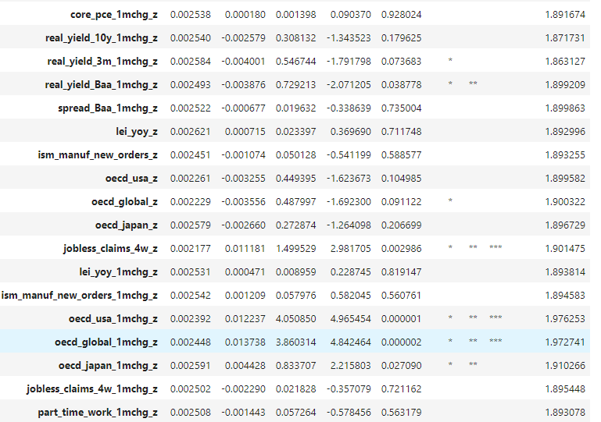
IN-SAMPLE UNIVARIATE REGRESSIONS:
FOR 1-MONTH FORECAST HORIZONS OF EXCESS RETURN (equities – treasuries) – contains look-ahead bias.
Source: copy from my notebook

Slide 21
IN-SAMPLE UNIVARIATE REGRESSIONS:
FOR 1-MONTH FORECAST HORIZONS OF EXCESS RETURN (equities – treasuries) – contains look-ahead bias.
Serial Correlation issues?
It is a well-known fact that monthly predictive regression of returns on lagged predictors suffer heavily from serial correlation for longer term forecasting (or as soon as overlapping returns come into play: already for 2-months out). This is because the dependent variable (some return) contains overlapping periods: for example, The 12-month return known in February contains 11 overlapping periods with the 12-month return known in January.
This causes bias in the standard errors of the coefficients ➔ test statistics might be totally off ➔ hypothesis significance testing might be totally off.
Serial correlation is often corrected through Newey-West test statistics (HAC corrections for heter and autocorrelation) or ARMAX models. To do: future research once the out-of-sample issue is solved.
We use short-term forecasting - monthly forecasting with monthly returns - and have no overlapping returns. The Durbin-Watson statistic for each univariate regression is close to 2, indicating there is hardly serial correlation. Hence, we don’t adjust anything for now. But we would have to, if we forecasted for longer periods.
Observations from our regression:
In-sample R-squared is extremely low for short term forecasts as there is massive white noise in the short run. Academic sources often mention R-squared lower than 5%. We confirm and find a maximum R-squared of 4% (the z-score of the 1-month change in the usa oecd value). A low R-squared does not mean however that results can’t be useful.
We find:
9 significant predictors with p < 0.1
7 significant predictors with p < 0.05
3 significant predictors with p < 0.01

Slide 22
IN-SAMPLE UNIVARIATE REGRESSIONS:
FOR 1-MONTH FORECAST HORIZONS OF EXCESS RETURN (equities – treasuries) – contains look-ahead bias.
These 9 predictors are:
predictor | Predictor general | beta | R-sq | General comments
yield_3m_1mchg_z | The z-score of the 1-month change in the 3-month Tbill yield | - 0.005 | 0.7% | On average, and in-sample, a short-term yield-shock – defined as absolute change over last month – would lead to lower excess returns and vice vera.
yield_Baa_1mchg_z | The z-score of the 1-month change in the yield of Baa paper. | -0.005 | 1%
real_yield_3m_1mchg_z | The z-score of the 1-month change in the real 3-month Tbill yield (Tbill yield – Core PCE deflator) | -0.004 | 0.6%
real_yield_Baa_1mchg_z | The z-score of the 1-month change in the real Baa yield (Baa yield – Core PCE deflator) | -0.004 | 0.7%
oecd_global_z | The z-score of the global leading oecd -ndicator | -0.004 | 0.5%
jobless_claims_4w_z | The z-score of the global leading oecd indicator | 0.011 | 1.5% | The sign is weird and doesn’ make much sense at first sight. However, markets are forward looking and might discount Fed cuts at very high jobless claims. On average, higher jobless claims are associated with higher returns and vice versa.
oecd_usa_1mchg_z | The z-score of the 1-month change in the USA leading oecd-indicator | 0.012 | 4% | On average, and in-sample, positive OECD-shocks – defined as absolute change in OECD-indicator over last month – would lead to higher excess returns in the next month and vice versa.
oecd_global_1mchg_z | The z-score of the 1-month change in the global leading oecd-indicator | 0.014 | 3.9%
oecd_japan_1mchg_z | The z-score of the 1-month change in the Japan leading oecd-indicator | 0.004 | 0.8%

Slide 23
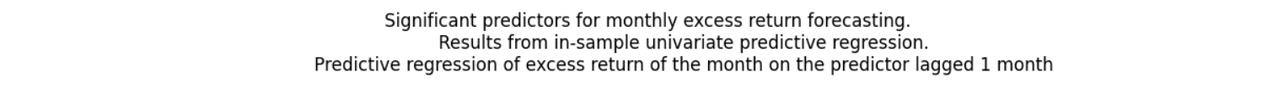
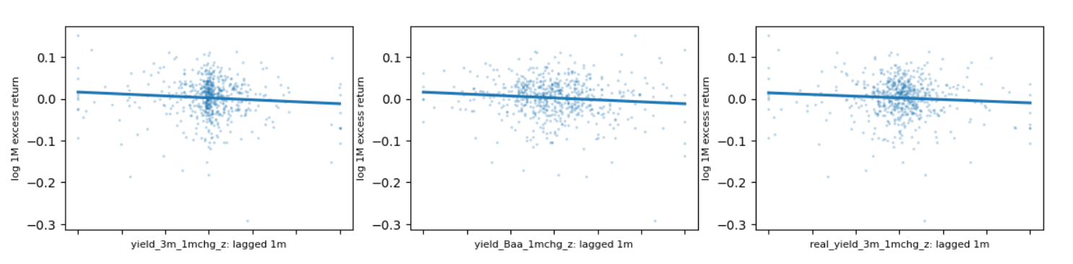
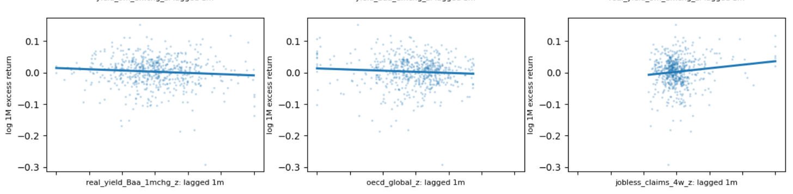
IN-SAMPLE UNIVARIATE REGRESSIONS:
Source: copy from my notebook

Slide 24
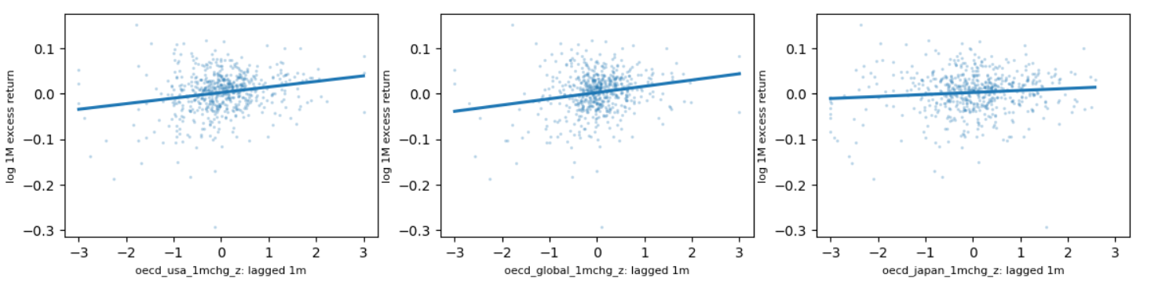
IN-SAMPLE UNIVARIATE REGRESSIONS:
Source: copy from my notebook

Slide 25
IN-SAMPLE UNIVARIATE REGRESSIONS:
FOR 1-MONTH FORECAST HORIZONS OF EXCESS RETURN (equities – treasuries) – contains look-ahead bias.
We generalize a bit from the in-sample results. Global macro traders with a short horizon would do well into tracking short-term:
Shocks in the yield front (short- and long-term yields and real yields)
Shocks in the growth front using OECD-indicators. However, OECD suffers from a revision problem and traders would do well in tracking a variety of growth indicators.
To do future research: include sentiment, vol variables as well as valuation indicators.

Slide 26
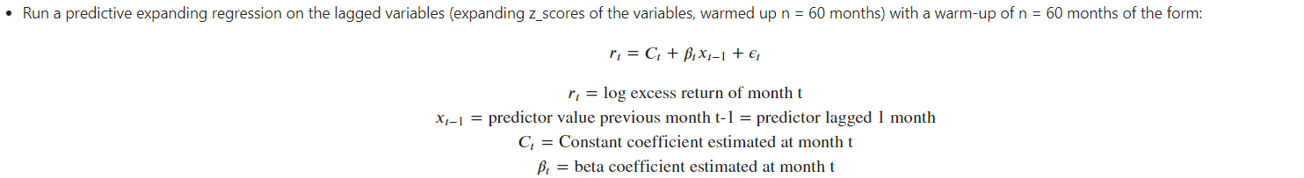
OUT – OF-SAMPLE UNIVARIATE REGRESSIONS: 1984 – Nov-2022
Univariate out-of-sample recursive regressions:
On each predictor – also those that were not significant in-sample- we perform an out-of-sample regression as follows:
As predictors we no longer use in-sample z-scores. We know calculate z-scores on an expanding window with a warm-up of 60 months.
We then perform expanding window predictive regressions with a warm-up of 60 months:
Each month (month-end in real life) we run a univariate, predictive and recursive regression on the data that is known until that month. Form*:
Each month - and for each predictor - we have estimated coefficients at month t that used all data from the warm-up date until month t. In contrast to in-sample predictive regressions our coefficients are now time-varying and are updated as new information becomes available. Expanding window regressions do not contain look-ahead bias as they only use information that was available for the investor at time t. Out z-scores are also adjusted for look-ahead bias as they are calculated on an expanding window as well. The downside of all this is that we have lost about 10 years of data (warm-up expanding z-score is 60 months and then we use a warm-up of 60 months again to warm-up our predictive regression).
*copy from my notebook
*copy from my notebook

Slide 27

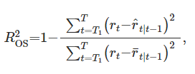
OUT – OF-SAMPLE UNIVARIATE REGRESSIONS: 1984 – Nov-2022
Since we have estimated coefficients for each month - and for each variable - we can now use the regression results (coefficients) and forecast the log excess return of next month (forecast for t+1 at month t) per predictor. Our forecast is of form:
To estimate out-of-sample efficacy we calculate the Campbell & Thompson out-of-sample R-squared - for each predictor and or the C-mean - defined as:
The out-of-sample R-squared calculates the proportional (percentage) reduction in MSFE (mean squared forecast error) of the forecast that utilizes the predictor forecast versus a forecast that uses a naïve forecast (the running mean)
Numerator: MSFE of forecast that utilizes the predictor forecast = sum(actual excess return – forecasted excess return)^2
Denominator: MSFE of naïve running forecast = sum (actual excess return – running historic mean of excess returns)^2
Out-of-sample R-squared = 1-(numerator/denominator)
*copy from my notebook

Slide 28
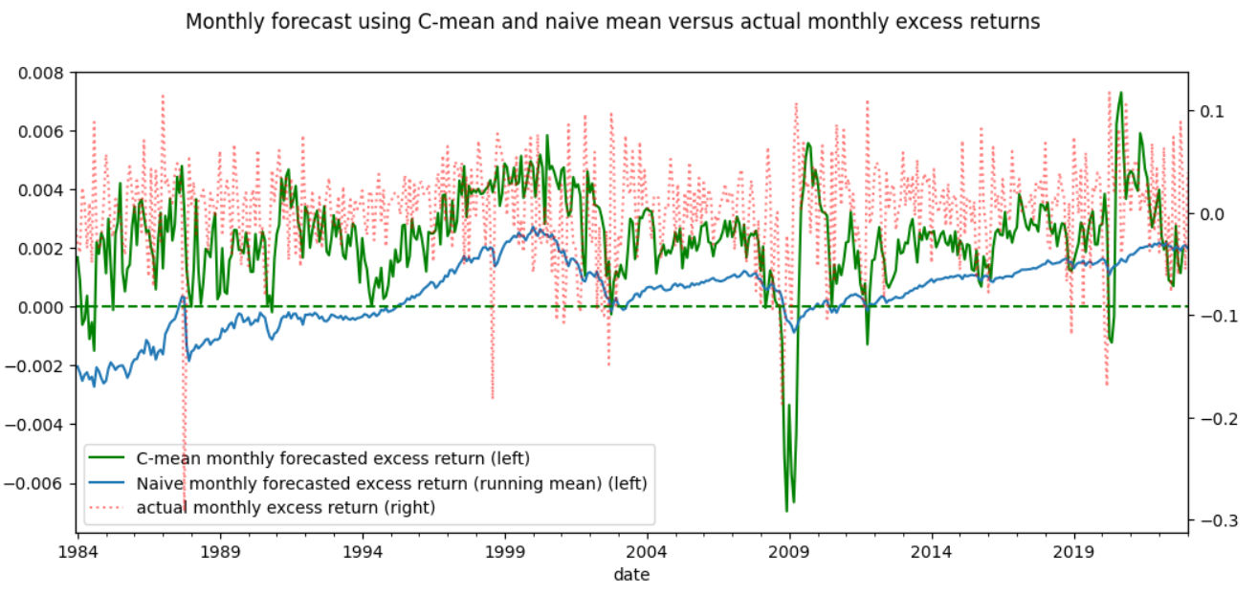
OUT – OF-SAMPLE UNIVARIATE REGRESSIONS: 1984 – Nov-2022
*copy from my notebook

Slide 29
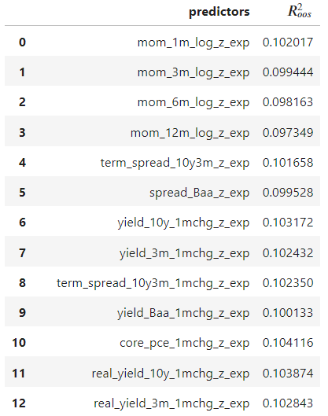
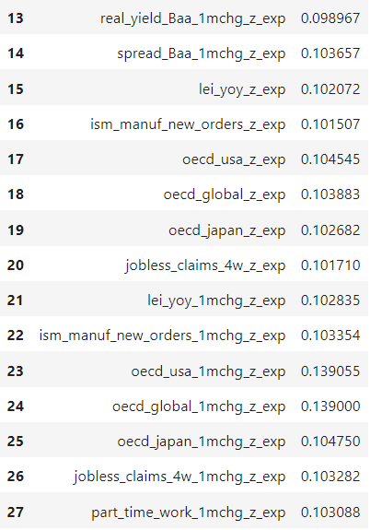
OUT – OF-SAMPLE UNIVARIATE REGRESSIONS: 1984 – Nov-2022
Our C-mean out-of-sample R-squared statistic is also around 0.1
*copy from my notebook

Slide 30
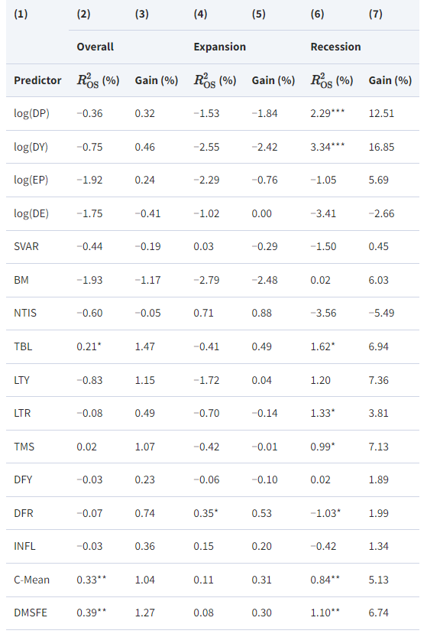
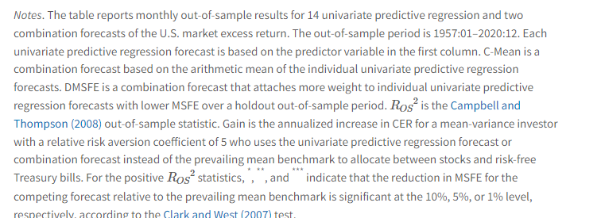
OUT – OF-SAMPLE R-squared from the paper 1957 – 2020
*Source: the Paper

Slide 31

UNFINISHED PROJECT
As the out-of-sample R-squared’s, we stopped the project here.
seem off versus the paper (though time period is different)
Seem off as they align almost all to 10%
Win some beers!
I haven’t found any error in my code or logic yet (multiple checks) but I’m sure there are. I encourage every reader and/or learner to dig into my notebook to find the error…Your price will be:
Gratitude
A mention on LinkedIn that will lead to eternal internet-fame
A good chat and a couple of beers from me at bar of choice!

